Slide 1
Risk Analysis and
Project Evaluation
January 2005
Campbell R. Harvey
Duke University
and
National Bureau of Economic Research

Slide 2
Risk Analysis and Project Evaluation
Plan
Cash Flow versus Discount Rate
Approaches to Cost of Capital Measurement
Recommended Framework
Comparison of Methods
Conversion of Cash Flows
Industry Adjustments
Project Specific Adjustments
Risk Worksheet
Conclusions
Appendices

Slide 3
Risk Analysis and Project Evaluation
1. Cash Flow vs. Discount Rate
Basic Project Evaluation:
Forecast nominal cash flows
Currency choice (assume US$)
Decide what risks will be reflected in cash flows and those in the discount rate
  Beware of double discounting

Slide 4
Risk Analysis and Project Evaluation
1. Cash Flow vs. Discount Rate
Simple example:
Assume a simple project with expected $100 in perpetual cash flows
If located in the U.S., the discount rate would be 10% and
  Value= $100/0.10= $1,000

Slide 5
Risk Analysis and Project Evaluation
1. Cash Flow vs. Discount Rate
Simple example:
However, project is not located in the U.S. but a risky country
If we reflect the country risk in the discount rate, the rate rises to 20%
  Value = $100/0.20 = $500

Slide 6
Risk Analysis and Project Evaluation
1. Cash Flow vs. Discount Rate
Simple example:
If we reflect the country risk in the cash flows, the value is identical
  Value = $50/0.10 = $500

Slide 7
Risk Analysis and Project Evaluation
1. Cash Flow vs. Discount Rate
Our approach
We will propose methods that deliver discount rates that reflect country risk.
As our example showed, it is a simple matter of shifting the country risk from the discount rate to the cash flows.

Slide 8
Risk Analysis and Project Evaluation
1. Cash Flow vs. Discount Rate
Our approach
Indeed, we will often do this.
  That is, we will use quantitative methods to get a measurement of country risk in the discount rate.
  Use the country risk adjustment in the cash flows (and adjust discount rate down accordingly).
  Use Monte Carlo methods on cash flows rather than cash flows and discount rate.

Slide 9
Risk Analysis and Project Evaluation
2. International Cost of Capital
Many different approaches:
Identical Cost of Capital (all locations)
World CAPM or Multifactor Model (Sharpe-Ross)
Segmented/Integrated (Bekaert-Harvey)
Bayesian (Ibbotson Associates)
Country Risk Rating (Erb-Harvey-Viskanta)
CAPM with Skewness (Harvey-Siddique)

Slide 10
Risk Analysis and Project Evaluation
2. International Cost of Capital
Goldman-integrated sovereign yield spread model
Goldman-segmented
Goldman-EHV hybrid
CSFB volatility ratio model
CSFB-EHV hybrid
Damoradan

Slide 11
Risk Analysis and Project Evaluation
2. International Cost of Capital
Identical Cost of Capital
Ignores the fact that shareholders require different expected returns for different risks

Slide 12
Risk Analysis and Project Evaluation
2. International Cost of Capital
Identical Cost of Capital
Risky investments get evaluated with too low of a discount rate (and look better than they should)
Less risky investments get evaluated with too high of a discount rate (and look worse than they are)
Hence, method destroys value
Avoid

Slide 13
Risk Analysis and Project Evaluation
2. International Cost of Capital
World CAPM
Sharpe’s Capital Asset Pricing Model is the mainstay of economic valuation
Simple formula
Intuition is that required rate of return depends on how the investment contributes to the volatility of a well diversified portfolio

Slide 14
Risk Analysis and Project Evaluation
2. International Cost of Capital
World CAPM
Expected discount rate (in U.S. dollars) on investment that has average in a country
= riskfree + β_{ι} x world risk premium
Beta is measured relative to a “world” portfolio
OK for developed markets if we allow risk to change through time (Harvey 1991)

Slide 15
Risk Analysis and Project Evaluation
2. International Cost of Capital
World CAPM
Strong assumptions needed
Perfect market integration
Mean-variance analysis implied by utility assumptions
Fails in emerging markets

Slide 16
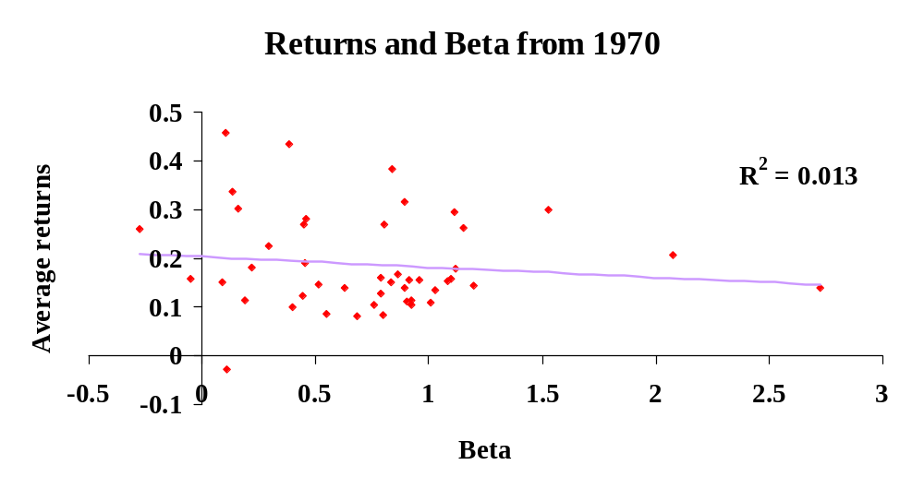
Risk Analysis and Project Evaluation
2. International Cost of Capital
Should be a positive relation, with higher risk associated with higher return!
But perhaps we should look at a more recent sample of data.

Slide 17
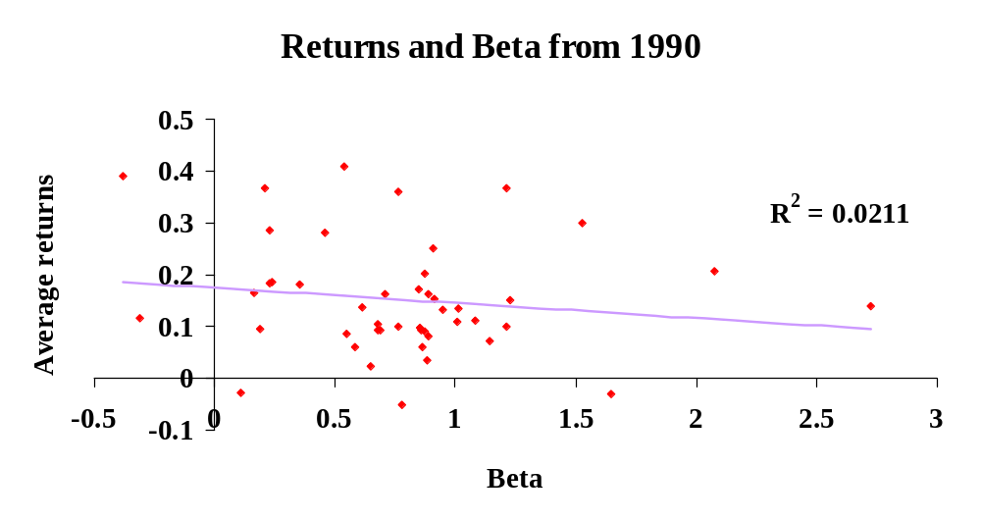
Risk Analysis and Project Evaluation
2. International Cost of Capital
Still goes the wrong way - even with data from 1990!

Slide 18
Risk Analysis and Project Evaluation
2. International Cost of Capital
World CAPM
OK to use in developed markets
May give unreliable results in smaller, less liquid developed markets

Slide 19
Risk Analysis and Project Evaluation
2. International Cost of Capital
Segmented/Integrated CAPM
CAPM assumes that markets are perfectly integrated
  foreign investors can freely invest in the local market
  local investors can freely invest outside the local market
Many markets are not integrated so we need to modify the CAPM

Slide 20
Risk Analysis and Project Evaluation
2. International Cost of Capital
Segmented/Integrated CAPM
Bekaert and Harvey (1995)
If market integrated, world CAPM holds
If market segmented, local CAPM holds
If going through the process of integration, a combination of two holds

Slide 21
Risk Analysis and Project Evaluation
2. International Cost of Capital
Segmented/Integrated CAPM
Estimate world beta and expected return
= riskfree + β_{ιw} x world risk premium
Estimate local beta and expected return
= local riskfree + β_{ιL} x local risk premium

Slide 22
Risk Analysis and Project Evaluation
2. International Cost of Capital
Segmented/Integrated CAPM
Put everything in common currency terms
Add up the two components.
CC= w[world CC] + (1-w)[local CC]
Weights, w, determined by variables that proxy for degree of integration, like size of trade sector and equity market capitalization to GDP

Slide 23
Risk Analysis and Project Evaluation
2. International Cost of Capital
Segmented/Integrated CAPM
Weights are dynamic, as are the risk loadings and the risk premiums
Downside: hard to implement; only appropriate for countries with equity markets
Recommendation: Wait

Slide 24
Risk Analysis and Project Evaluation
2. International Cost of Capital
Ibbotson Associates
(Recognized expert in cost of capital calculation)
Approach recognizes that the world CAPM is not the best model
Ibbotson approach combines the CAPM’s prediction with naïve prediction based on past performance.

Slide 25
Risk Analysis and Project Evaluation
2. International Cost of Capital
Ibbotson Associates
STEPS
Calculate world risk premium=U.S. risk premium divided by the beta versus the MSCI world
Estimate country beta versus world index
Multiply this beta times world risk premium

Slide 26
Risk Analysis and Project Evaluation
2. International Cost of Capital
Ibbotson Associates
Add in 0.5 times the ‘intercept’ from the initial regression. “This additional premium represents the compensation an investor receives for taking on the considerable risks of the emerging markets that is not explained by beta alone.”

Slide 27
Risk Analysis and Project Evaluation
2. International Cost of Capital
Ibbotson Associates
Gives unreasonable results in some countries
Only useful if equity markets exist
Ibbotson Associates does not even use it
Recommendation: Do not use this version. Ibbotson has alternative methods available.

Slide 28
Risk Analysis and Project Evaluation
2. International Cost of Capital
CAPM with Skewness
For years, economists did not understand why people spend money on lottery tickets and horse betting
The expected return is negative and the volatility is high
Behavioral explanations focused on “risk loving”

Slide 29
Risk Analysis and Project Evaluation
2. International Cost of Capital
CAPM with Skewness
But this is just preference for positive skewness (big positive outcomes)
People like positive skewness and dislike negative skewness (downside)

Slide 30
Risk Analysis and Project Evaluation
2. International Cost of Capital
CAPM with Skewness
Most are willing to pay extra for an investment that adds positive skewness (lower hurdle rate), e.g. investing in a startup with unproven technology

Slide 31
Risk Analysis and Project Evaluation
2. International Cost of Capital
CAPM with Skewness
Harvey and Siddique (2000) tests of a model that includes time-varying skewness risk
Bekaert, Erb, Harvey and Viskanta detail the implications of skewness and kurtosis in emerging market stock selection

Slide 32
Risk Analysis and Project Evaluation
2. International Cost of Capital
CAPM with Skewness
Model still being developed
Skewness similar to many “real options” that are important in project evaluation
Recommendation: Wait

Slide 33
Risk Analysis and Project Evaluation
2. International Cost of Capital
Goldman-Integrated*
This model is widely used by McKinsey, Salomon and many others.
Addresses the problem that the CAPM gives a discount rate too low.
Solution: Add the sovereign yield spread
*J.O. Mariscal and R. M. Lee, The valuation of Mexican Stocks: An extension of the capital
asset pricing model to emerging markets, Goldman Sachs, June 18, 1993.

Slide 34
Risk Analysis and Project Evaluation
2. International Cost of Capital
Goldman-Integrated
The sovereign yield spread is the yield on a U.S. dollar bond that a country offers versus a U.S. Treasury bond of the same maturity
The spread is said to reflect “country risk”

Slide 35
Risk Analysis and Project Evaluation
2. International Cost of Capital
Goldman-Integrated
STEPS
Estimate market beta on the S&P 500
Beta times historical US premium
Add sovereign yield spread plus the risk free

Slide 36
Risk Analysis and Project Evaluation
2. International Cost of Capital
Goldman-Integrated-EHV Hybrid
Goldman model only useful if you have sovereign yield spread
Use Erb, Harvey and Viskanta model to fit ratings on yield spread

Slide 37
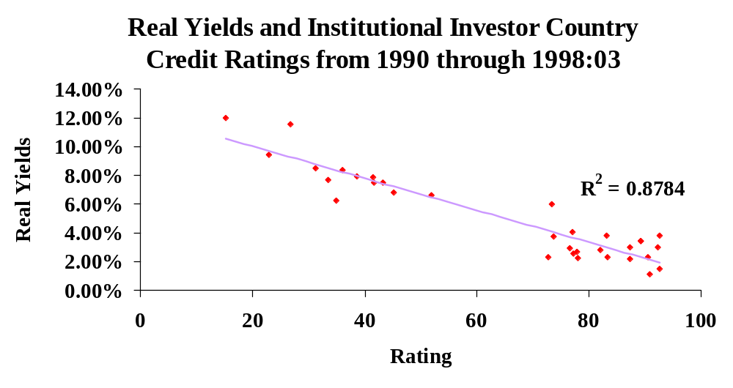
Risk Analysis and Project Evaluation
2. International Cost of Capital

Slide 38
Risk Analysis and Project Evaluation
2. International Cost of Capital
Goldman-Integrated-EHV Hybrid
You just need a credit rating (available for 136 countries now) and the EHV model will deliver the sovereign yield

Slide 39
Risk Analysis and Project Evaluation
2. International Cost of Capital
Goldman-Integrated-EHV Hybrid
Even adding this yield spread delivers a cost of capital that is unreasonably low in many countries
While you can get the yield spread in 136 countries with the EHV method, you can only get risk premiums for those countries with equity markets

Slide 40
Risk Analysis and Project Evaluation
2. International Cost of Capital
Goldman-Segmented
Main problem is the beta
It is too low for many risky markets
Solution: Increase the beta

Slide 41
Risk Analysis and Project Evaluation
2. International Cost of Capital
Goldman-Segmented
Modified beta=standard deviation of local market return in US dollars divided by standard deviation of the US market return
Beta times historical US premium
Add sovereign yield spread

Slide 42
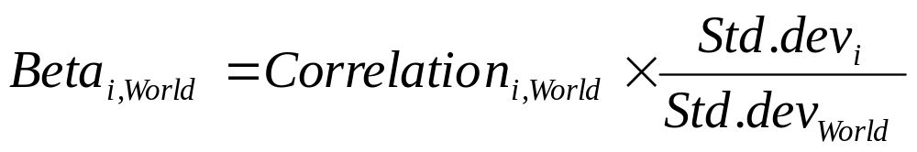
Risk Analysis and Project Evaluation
2. International Cost of Capital
Goldman-Segmented
Strange formulation. The usual beta is:
Using volatility ratio implies that the Correlation=1 !!

Slide 43
Risk Analysis and Project Evaluation
2. International Cost of Capital
Goldman-Segmented
No economic foundation for modification
No clear economic foundation for method in general
Recommendation: Not recommended

Slide 44
Risk Analysis and Project Evaluation
2. International Cost of Capital
CSFB
E[r_{i}]=SY_{i} + β_{i}{E[r_{us}-RF_{us}] x A_{i}} x K_{i}
SY_{i} = brady yield (use fitted from EHV)
β_{i} = the beta of a stock against a local index
L. Hauptman and S. Natella, The cost of equity in Latin American, Credit Swisse
First Boston, May 20, 1997.

Slide 45
Risk Analysis and Project Evaluation
2. International Cost of Capital
CSFB
E[r_{i}]=SY_{i} + β_{i}{E[r_{us}-RF_{us}] x A_{i}} x K_{i}
A_{i} =the coefficient of variation (CV) in the local market divided by the CV of the U.S. market) where CV = σ/mean.
K_{i} =“constant term to adjust for the interdependence between the risk-free rate and the equity risk premium”

Slide 46
Risk Analysis and Project Evaluation
2. International Cost of Capital
CSFB
No economic foundation
Complicated, nonintuitive and ad hoc
Recommendation: Avoid

Slide 47
Risk Analysis and Project Evaluation
2. International Cost of Capital
Damodaran
Idea is to adjust the sovereign spread to make it more like an equity premium rather than a bond premium
A. Damodaran, Estimating equity risk premiums, working paper, NYU, undated.

Slide 48
Risk Analysis and Project Evaluation
2. International Cost of Capital
Damodaran
Country Sovereign Equity std. dev.
equity = yield x ------------------
premium spread Bond std. dev.

Slide 49
Risk Analysis and Project Evaluation
2. International Cost of Capital
Damodaran
Advantage: Recognizes that you just can’t use the bond yield spread as a plug number in the CAPM
Disadvantage: Assumes that Sharpe ratios for stocks and bonds must be the same in any particular country.

Slide 50
Risk Analysis and Project Evaluation
3. Recommended Framework
Country Risk Rating Model
Erb, Harvey and Viskanta (1995)
Credit rating a good ex ante measure of risk
Impressive fit to data
C.B. Erb, C. R. Harvey and T. E. Viskanta, Expected returns and volatility in 135
countries, Journal of Portfolio Management, 1995.

Slide 51
Risk Analysis and Project Evaluation
3. Recommended Framework
Country Risk Rating Model
Erb, Harvey and Viskanta (1995)
Explore risk surrogates:
  Political Risk,
  Economic Risk,
  Financial Risk and
  Country Credit Ratings

Slide 52
Risk Analysis and Project Evaluation
3. Recommended Framework
Country Risk Rating Model
Sources
Political Risk Services’ International Country Risk Guide
Institutional Investor’s Country Credit Rating
Euromoney’s Country Credit Rating
Moody’s
S&P

Slide 53
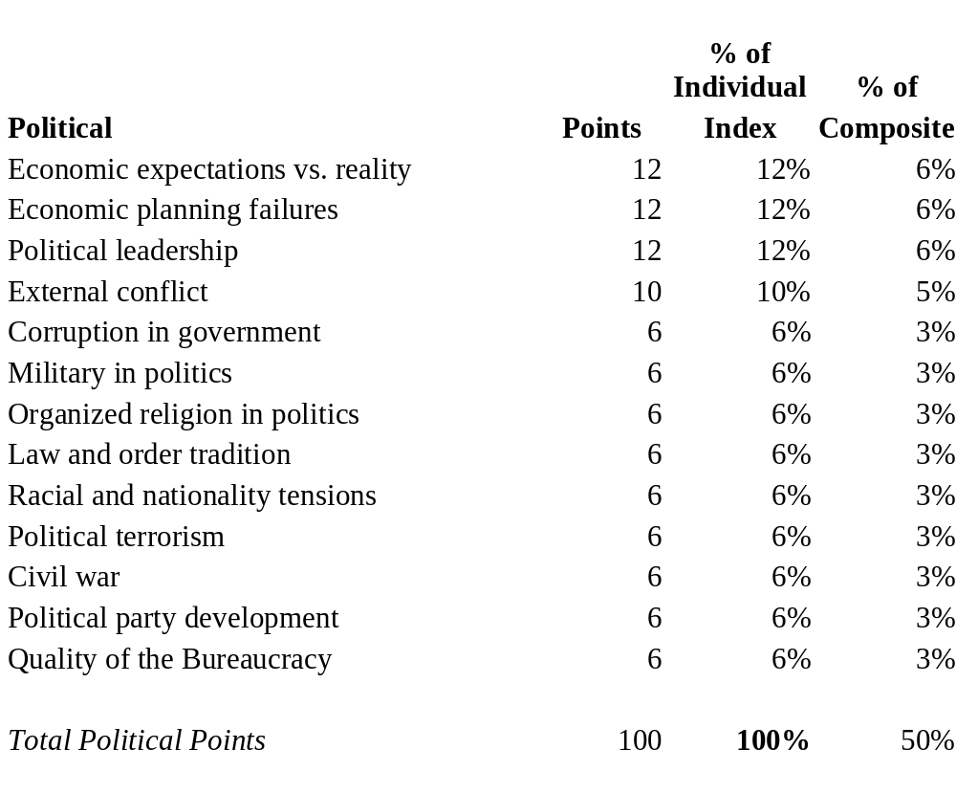
Risk Analysis and Project Evaluation
3. Recommended Framework
Political risk. International Country Risk Guide
See appendix for more detail

Slide 54
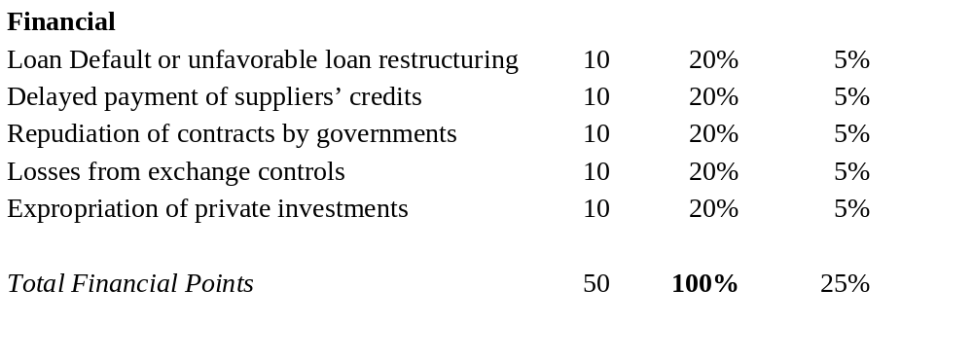
Risk Analysis and Project Evaluation
3. Recommended Framework
Financial risk. International Country Risk Guide
See appendix for more detail

Slide 55
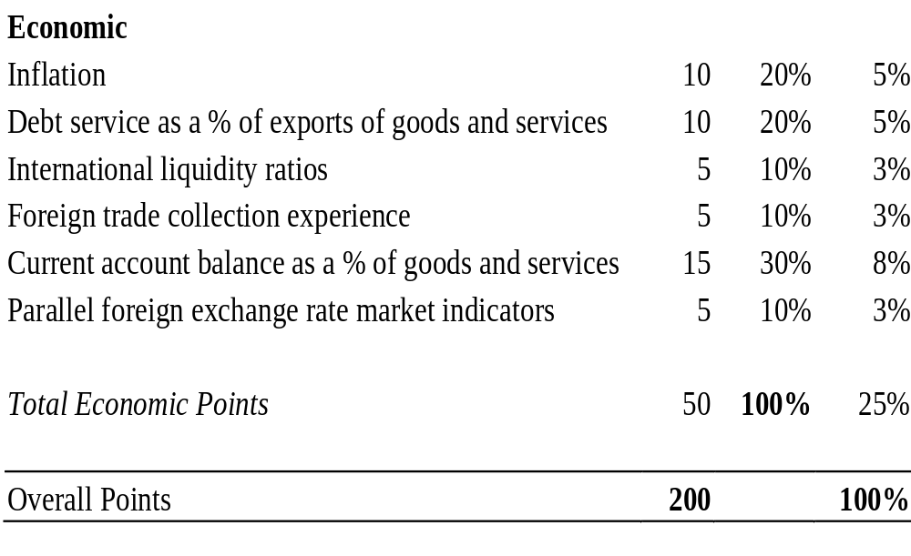
Risk Analysis and Project Evaluation
3. Recommended Framework
Economic risk. International Country Risk Guide
See appendix for more detail

Slide 56
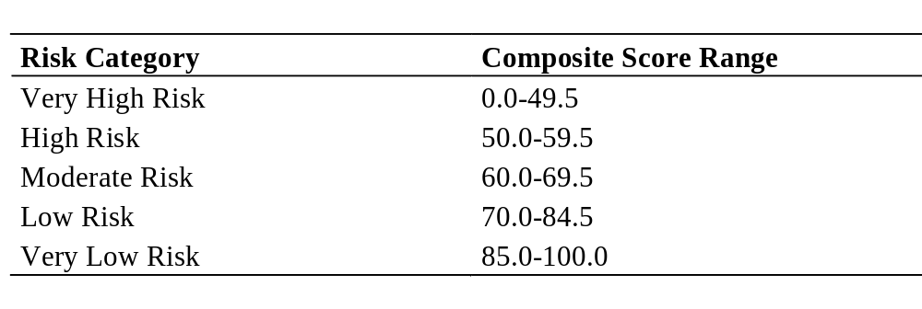
Risk Analysis and Project Evaluation
3. Recommended Framework
International Country Risk Guide Risk Categories
See appendix for more detail

Slide 57
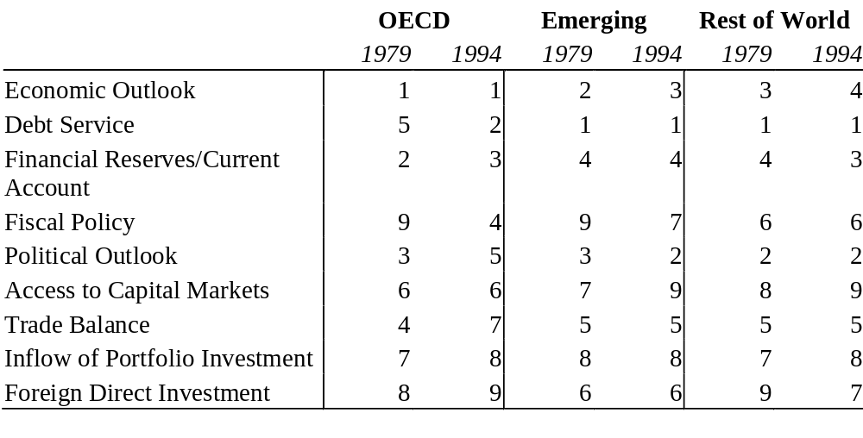
Risk Analysis and Project Evaluation
3. Recommended Framework
Institutional Investor’s Country Credit Ratings

Slide 58
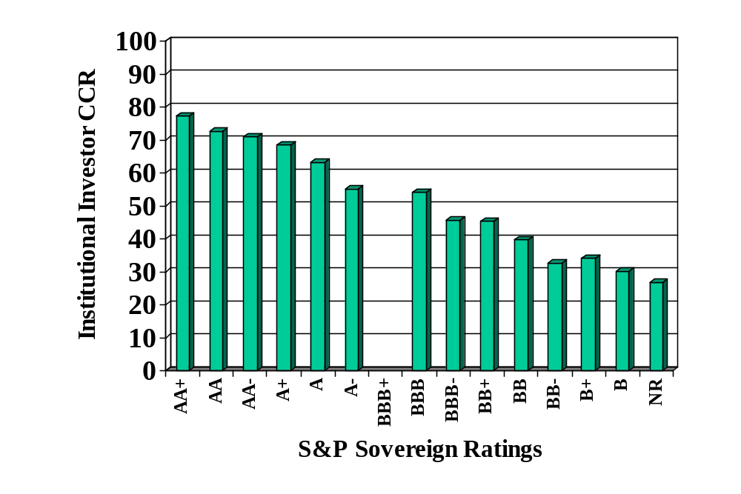
Risk Analysis and Project Evaluation
3. Recommended Framework
Ratings are correlated:

Slide 59
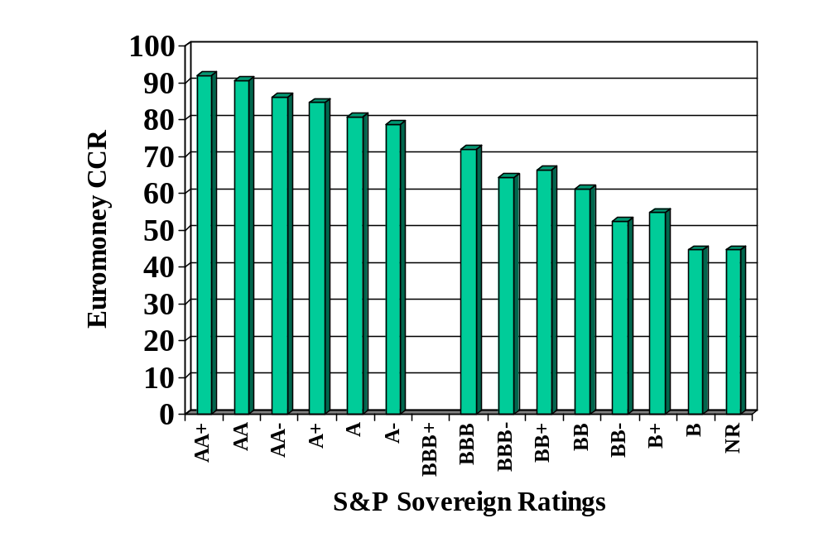
Risk Analysis and Project Evaluation
3. Recommended Framework
Ratings are correlated:

Slide 60
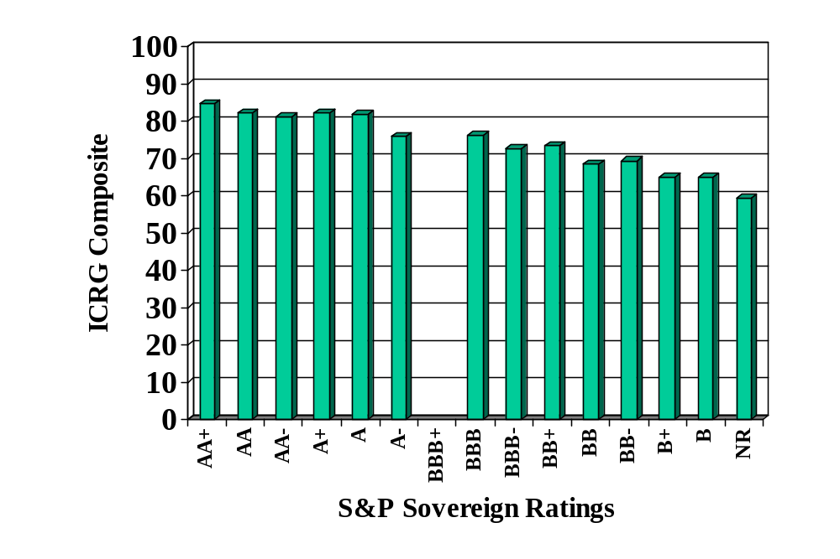
Risk Analysis and Project Evaluation
3. Recommended Framework
Ratings are correlated:

Slide 61
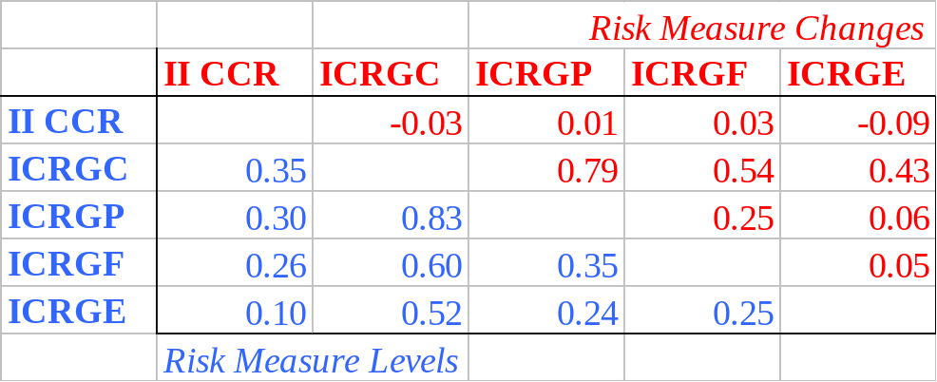
Risk Analysis and Project Evaluation
3. Recommended Framework
Ratings are correlated:

Slide 62
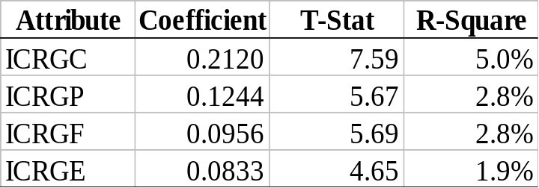
Risk Analysis and Project Evaluation
3. Recommended Framework
ICRG ratings predict changes in II ratings:

Slide 63
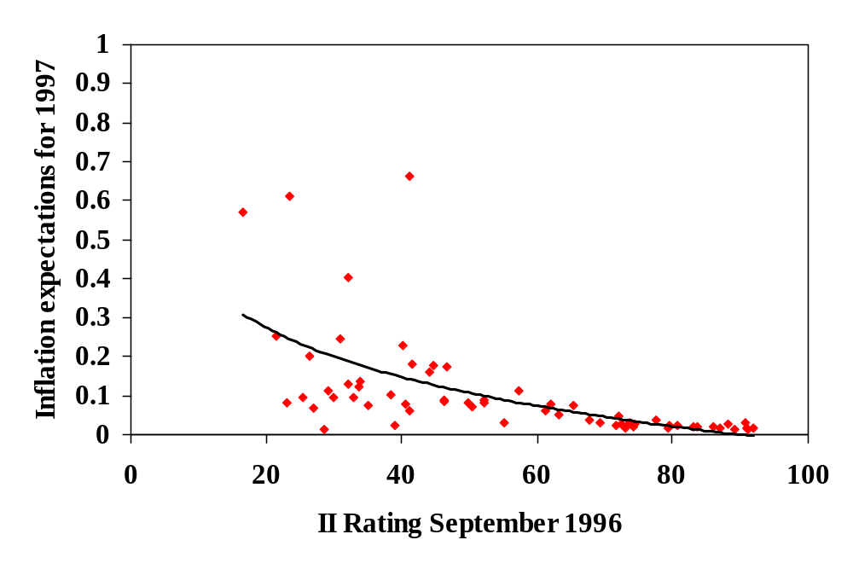
Risk Analysis and Project Evaluation
3. Recommended Framework
Ratings predict inflation:

Slide 64
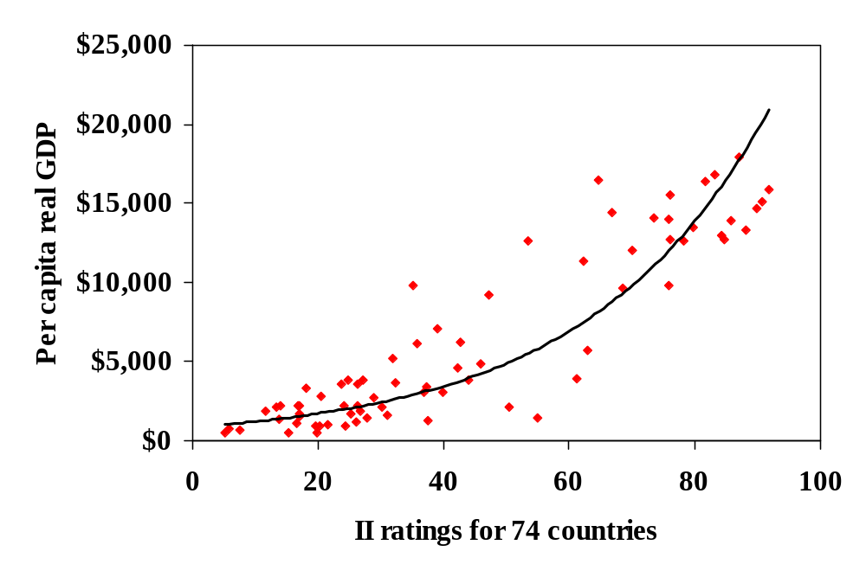
Risk Analysis and Project Evaluation
3. Recommended Framework
Ratings correlated with wealth:

Slide 65
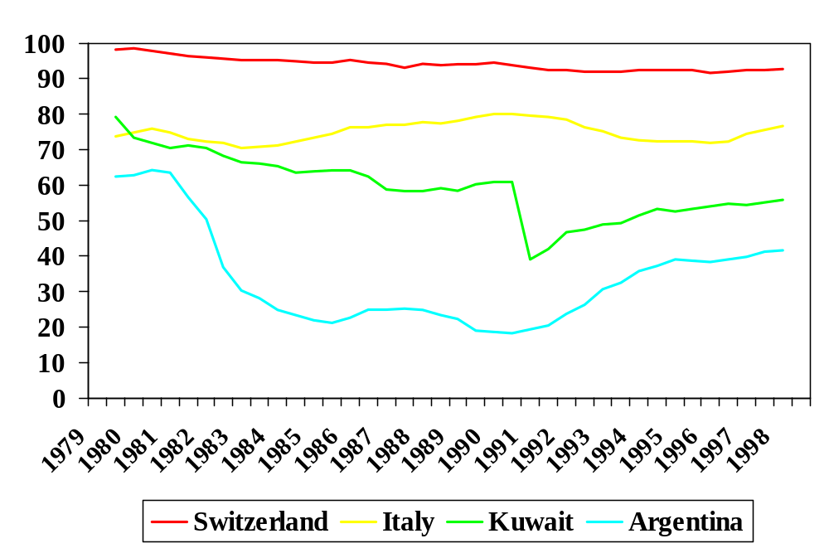
Risk Analysis and Project Evaluation
3. Recommended Framework
Time-series of ratings:

Slide 66
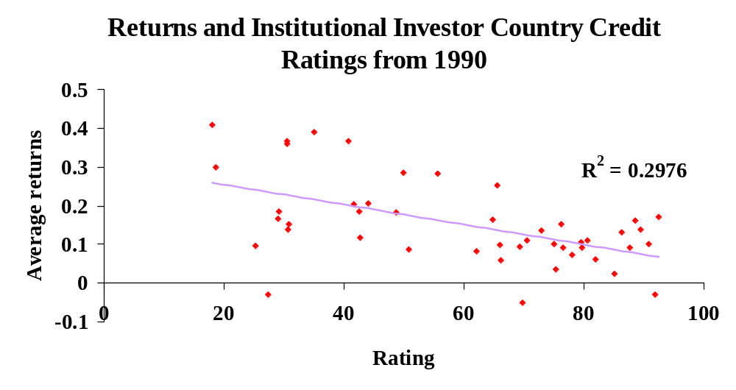
Risk Analysis and Project Evaluation
3. Recommended Framework
Fit is as good as it gets - lower rating (higher risk) commands higher
expected returns. Even in among US firms, our best model gets about
30% explanatory power.

Slide 67
Risk Analysis and Project Evaluation
3. Recommended Framework
Credit Rating Model
Intuitive
Can be used in 136 countries, that is, in countries without equity markets
Fits developed and emerging markets

Slide 68
Risk Analysis and Project Evaluation
3. Recommended Framework
Country Risk Rating Model
STEPS:
EVR = risk free + intercept - slope x Log(IICCR)
Where Log(IICCR) is the natural logarithm of the Institutional Investor Country Credit Rating

Slide 69
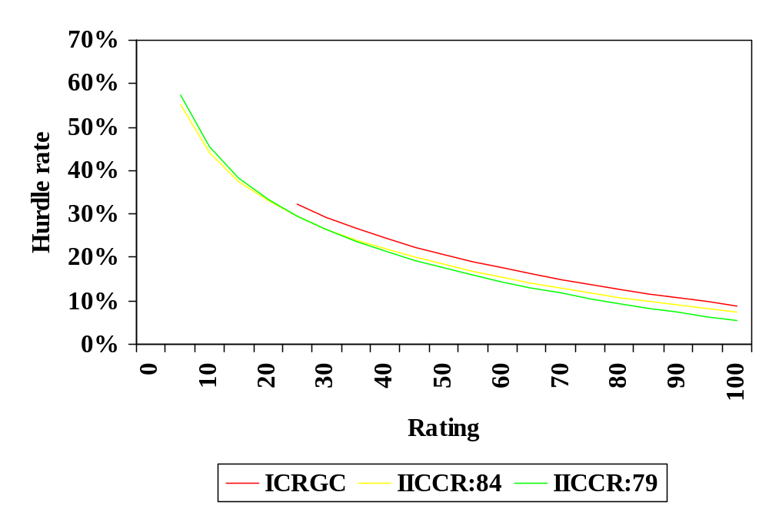
Risk Analysis and Project Evaluation
3. Recommended Framework
Easy to use:

Slide 70
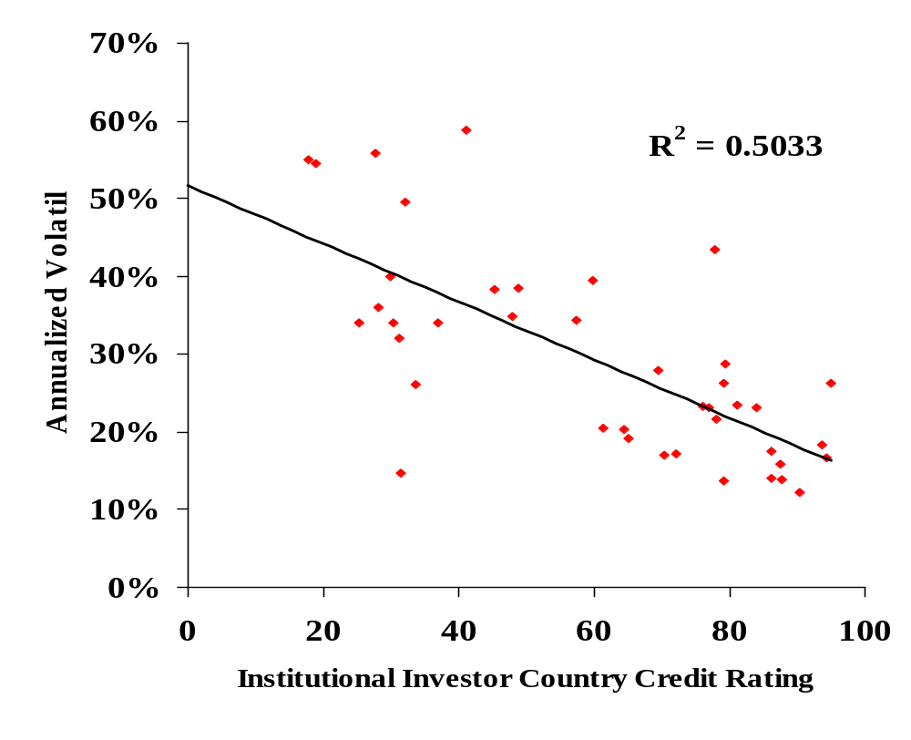
Risk Analysis and Project Evaluation
3. Recommended Framework
Also predicts volatility:

Slide 71
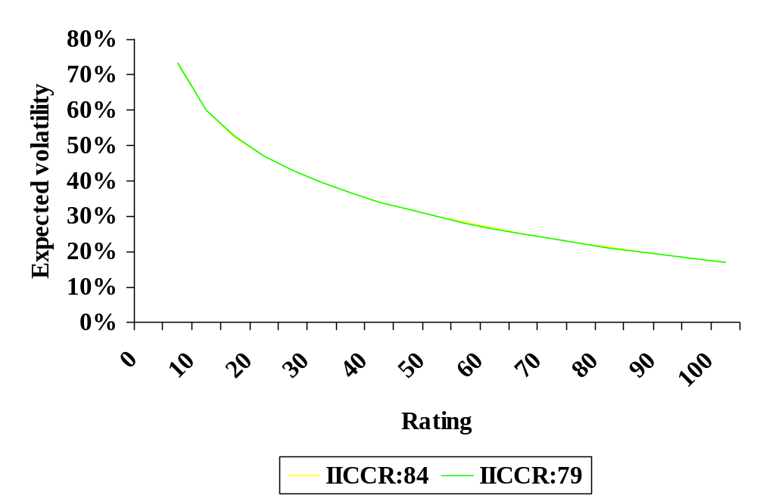
Risk Analysis and Project Evaluation
3. Recommended Framework
Fitted volatility:

Slide 72
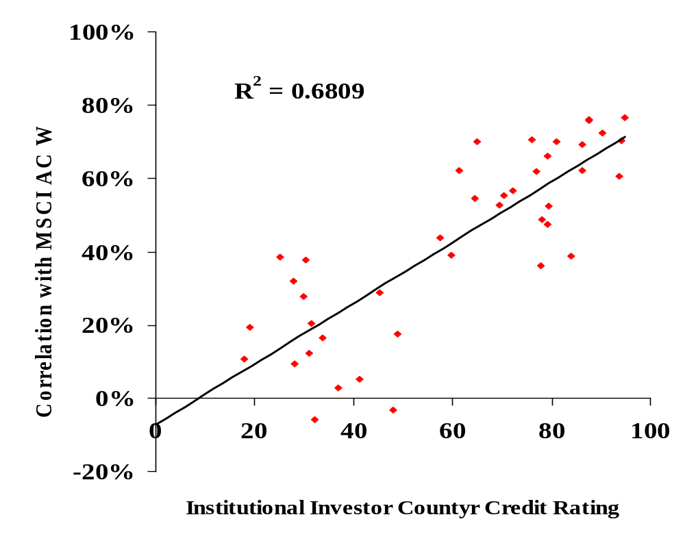
Risk Analysis and Project Evaluation
3. Recommended Framework
And correlation.

Slide 73
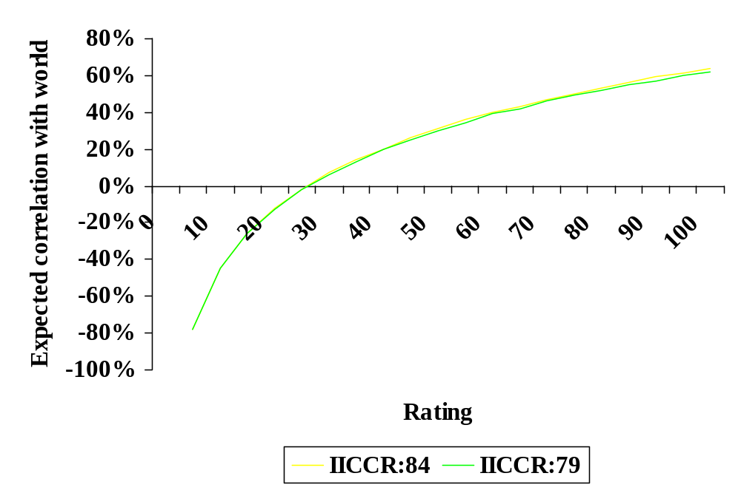
Risk Analysis and Project Evaluation
3. Recommended Framework
Fitted correlation.

Slide 74
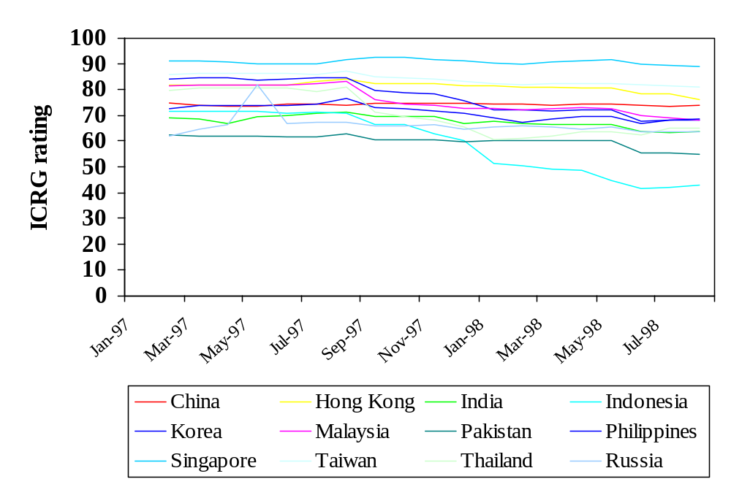
Risk Analysis and Project Evaluation
3. Recommended Framework
Asian Crisis.

Slide 75
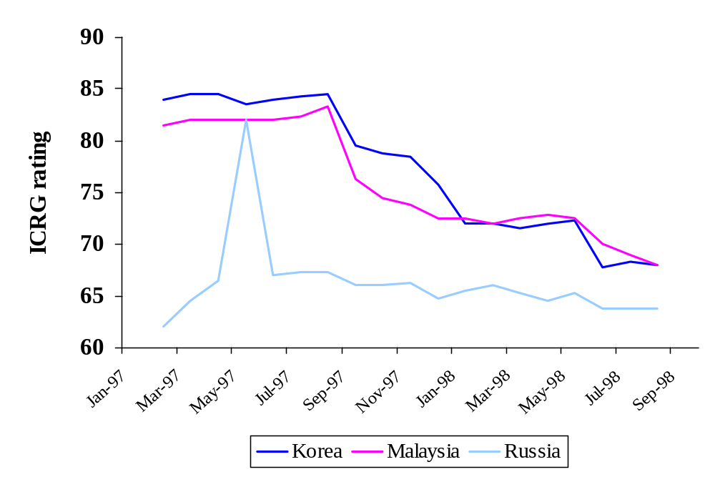
Risk Analysis and Project Evaluation
3. Recommended Framework
Asian Crisis.
Beginning of
crisis

Slide 76
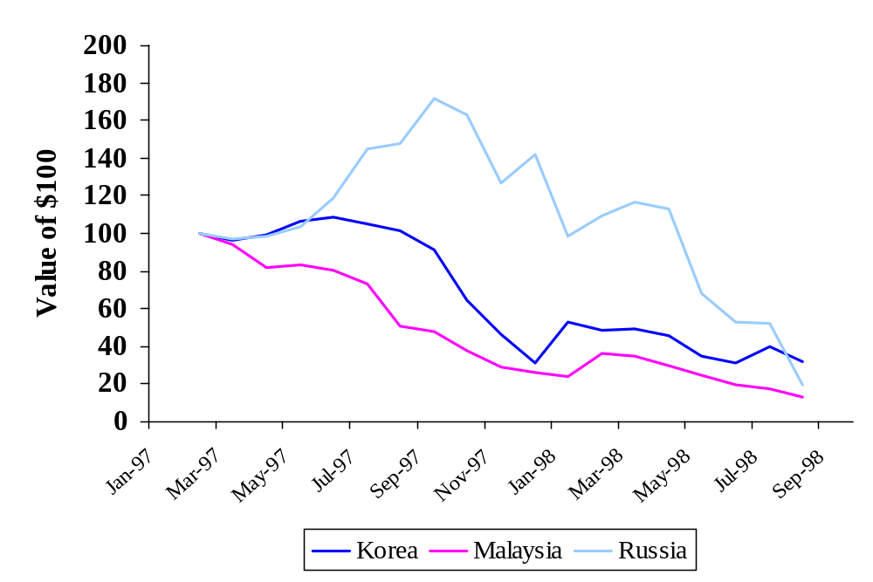
Risk Analysis and Project Evaluation
3. Recommended Framework
Value of US$100
Beginning of
crisis

Slide 77
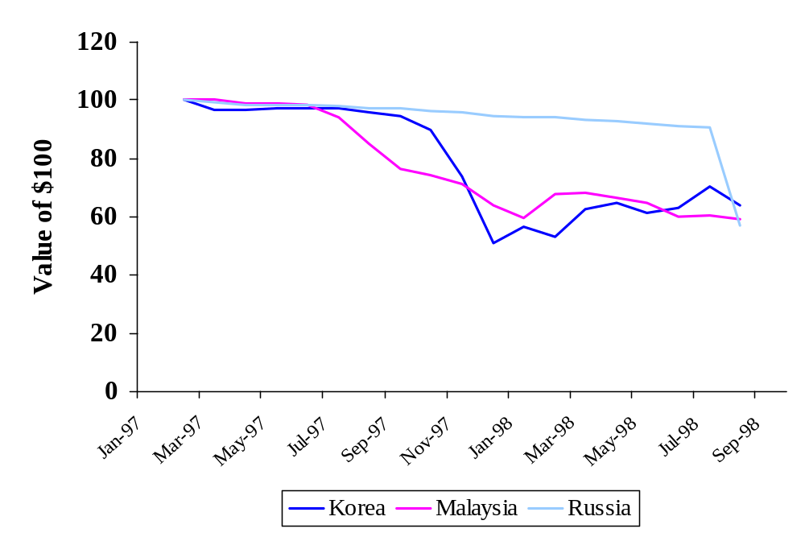
Risk Analysis and Project Evaluation
3. Recommended Framework
Value of local currency
(indexed at 100)
Beginning of
crisis

Slide 78
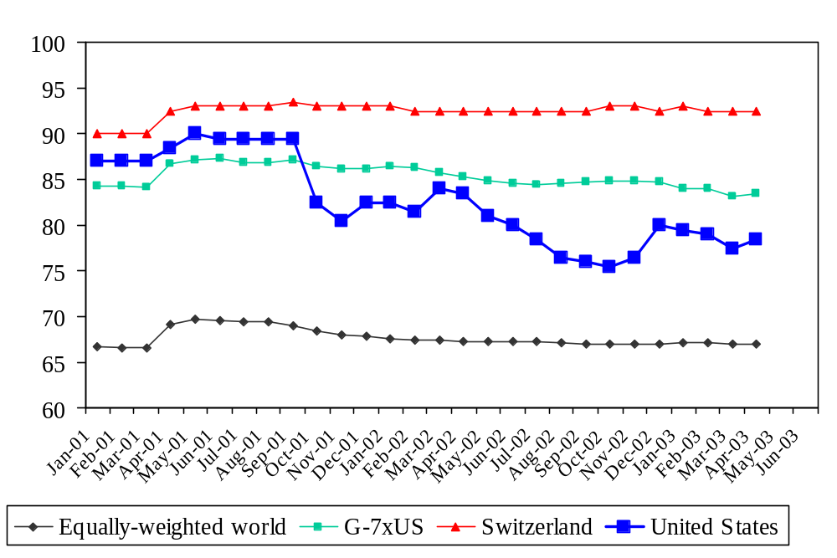
Risk Analysis and Project Evaluation
3. Recommended Framework

Slide 79
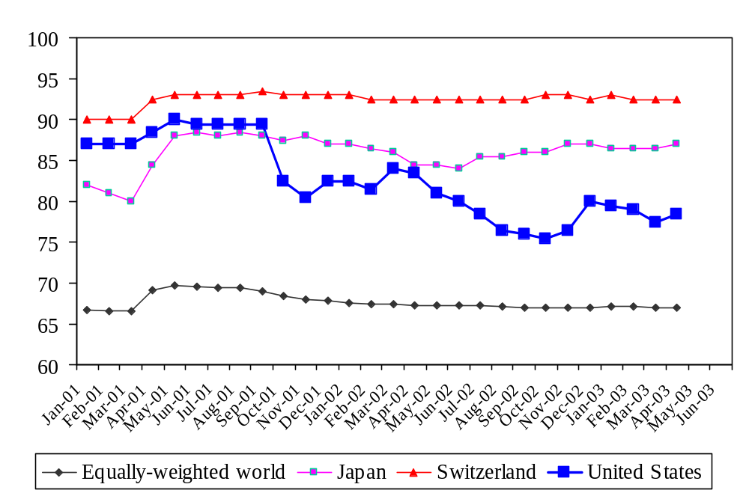
Risk Analysis and Project Evaluation
3. Recommended Framework
ICRG
Political Risk

Slide 80
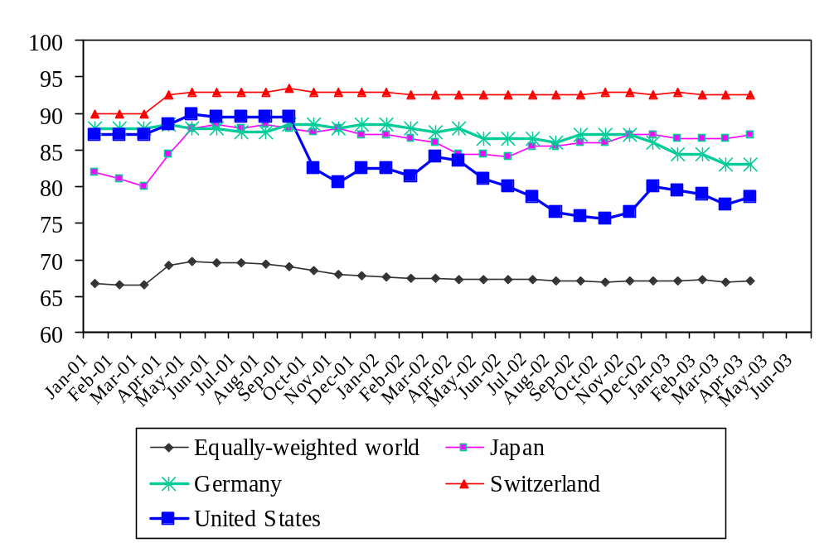
Risk Analysis and Project Evaluation
3. Recommended Framework
ICRG
Political Risk

Slide 81
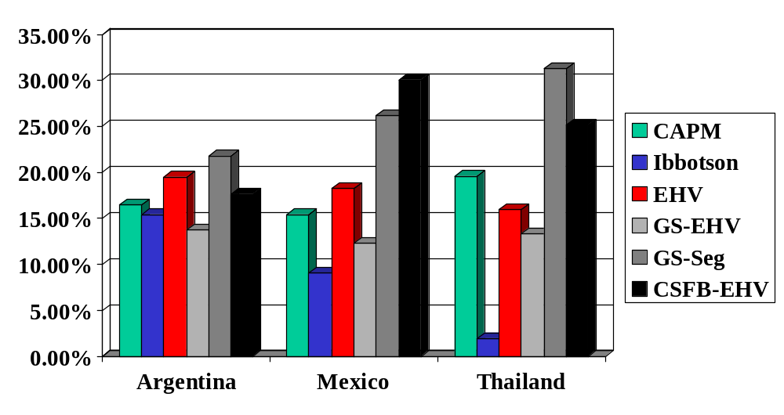
Risk Analysis and Project Evaluation
4. Comparison of Methods
68%

Slide 82
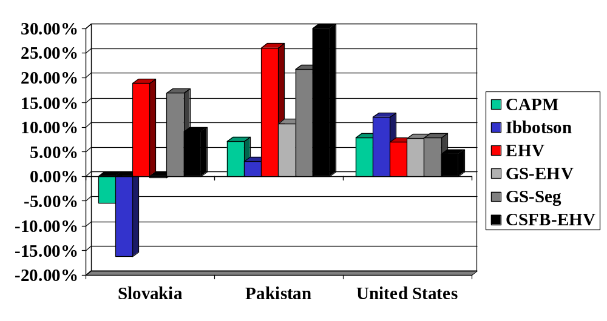
Risk Analysis and Project Evaluation
4. Comparison of Methods
537%

Slide 83
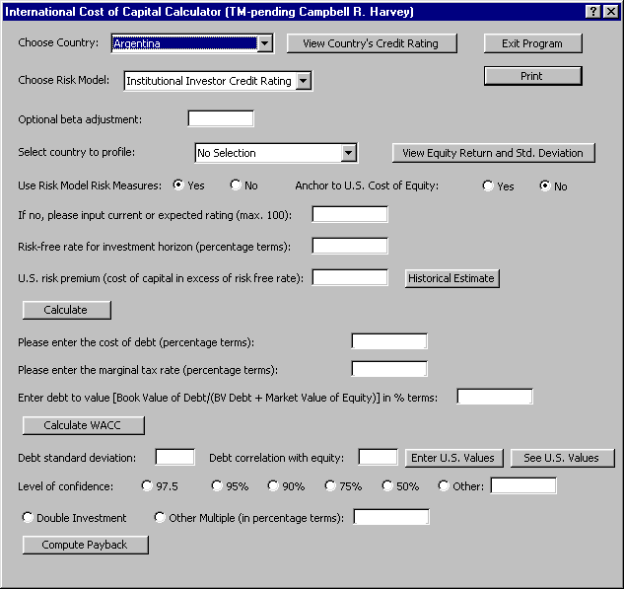
Risk Analysis and Project Evaluation
4. Comparison of Methods
Excel version

Slide 84
Risk Analysis and Project Evaluation
5. Conversion of Cash Flows
Forward Rate
Intuitive (expected exchange rate levels)
Works fine for developed countries
In emerging markets, there are two problems
  Data not readily available
  May reflect a risk premium (for default)

Slide 85
Risk Analysis and Project Evaluation
5. Conversion of Cash Flows
Forward Rate
Risk premium in forward rate will lead to “double discounting”
Think of the forward rate as the difference between two interest rates (local and U.S.).
  This difference will tell us something about inflation expectations
  But the local interest rate also reflects a default probability (sovereign risk)

Slide 86
Risk Analysis and Project Evaluation
5. Conversion of Cash Flows
Purchasing Power Parity
Simple theory: The exchange rate will depreciate by the difference in the local inflation rate and the U.S. inflation rate.
Empirical evidence shows this assumption works well in emerging markets (but not that well in developed markets)

Slide 87
Risk Analysis and Project Evaluation
5. Conversion of Cash Flows
Purchasing Power Parity
To operationalize, we need multiyear forecasts of inflation in the particular country as well as the U.S.
The difference in these rates is used to map out the expected exchange rates
The expected exchange rates are used to convert cash flows into US$
We then apply the US$ discount rate to US$ cash flows

Slide 88
Risk Analysis and Project Evaluation
5. Conversion of Cash Flows
Robustness
In some countries, it is difficult to get a good inflation forecast.
An alternative is the following:
  Subtract the sovereign spread from a local interest rate of the same duration
  Calculate a risk-adjusted forward rate
  Convert cash flows to USD using the risk-adjusted forward rate
  Discount with the ICCRC

Slide 89
Risk Analysis and Project Evaluation
6. Industry Adjustments
Industry Risk
ICCRC delivers a risk adjustment that reflects the weighted average risk of all industries within a country
For most emerging markets, the country risk component dominates differences due to industries.

Slide 90
Risk Analysis and Project Evaluation
6. Industry Adjustments
Industry Risk
Industry adjustment:
  Calculate the country risk premium from ICCRC (Country cost of equity capital – U.S. cost of capital)
  Using the industry beta, determine the U.S. industry cost of capital [=risk free + beta(U.S. risk premium)]
  Add the country risk premium to the U.S. industry cost of capital

Slide 91
Risk Analysis and Project Evaluation
7. Project Specific Adjustments
Project Risk Analysis
Operating Risk
  Pre-completion
  Post-completion
  Sovereign
Financial Risk

Slide 92
Risk Analysis and Project Evaluation
7. Project Specific Adjustments
Operating Risk
Pre-completion
  Resources available (quality/quantity)
  Technological risk (proven technology?)
  Timing risks (failure to meet milestones)
  Completion risk
Handle in cash flows and/or industry adjustment.

Slide 93
Risk Analysis and Project Evaluation
7. Project Specific Adjustments
Operating Risk
Post-completion
  Market risks (prices of outputs)
  Supply/input risk (availability)
  Throughput risk (material put through plus efficacy of systems operations)
  Operating cost
Handle in cash flows and/or industry adjustment.

Slide 94
Risk Analysis and Project Evaluation
7. Project Specific Adjustments
Operating Risk
Sovereign Risk (Macroeconomic)
  Exchange rate changes
  Currency convertibility and transferability
  Hyperinflation risk
Handle through discount rate. Inflation rate should be handled in the forecasted exchange rates used to put cash flows in USD

Slide 95
Risk Analysis and Project Evaluation
7. Project Specific Adjustments
Operating Risk
Sovereign Risk (Political/Legal)
  Expropriation
    Direct (seize assets)
    Diversion (seize project cash flows)
    Creeping (change taxation or royalty)
  Legal system
    May not be able to enforce property rights
Handle through discount rate

Slide 96
Risk Analysis and Project Evaluation
7. Project Specific Adjustments
Operating Risk
Sovereign Risk (Force Majeure)
  Political events
    Wars
    Labor strikes
    Terrorism
    Changes in laws
  Natural catastrophes
    Hurricanes/earthquakes/floods
Handle through discount rate

Slide 97
Risk Analysis and Project Evaluation
7. Project Specific Adjustments
Financial Risks
Probability of default
  Look at debt service coverage ratios and leverage through life of project
Check to see if internal rate of return is consistent with (at least) the financial risks
Handle through discount rate

Slide 98
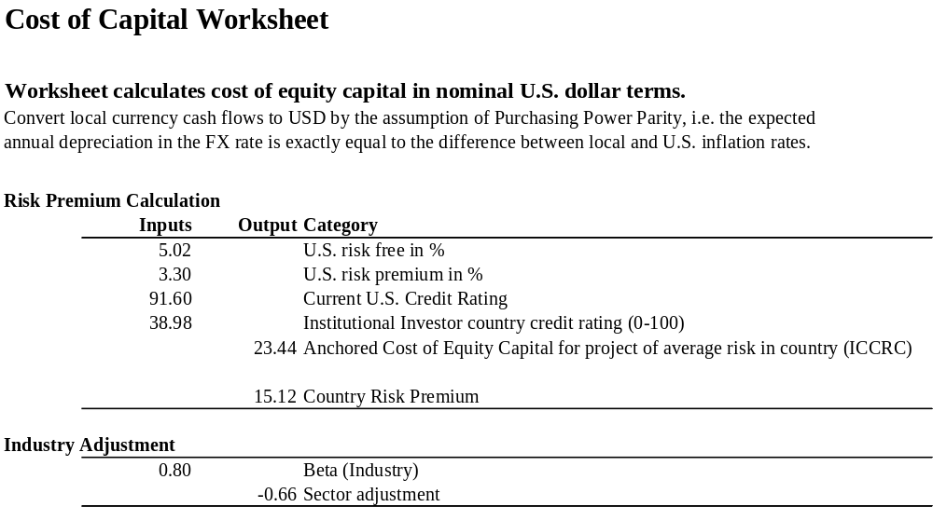
Risk Analysis and Project Evaluation
8. Risk Worksheet

Slide 99
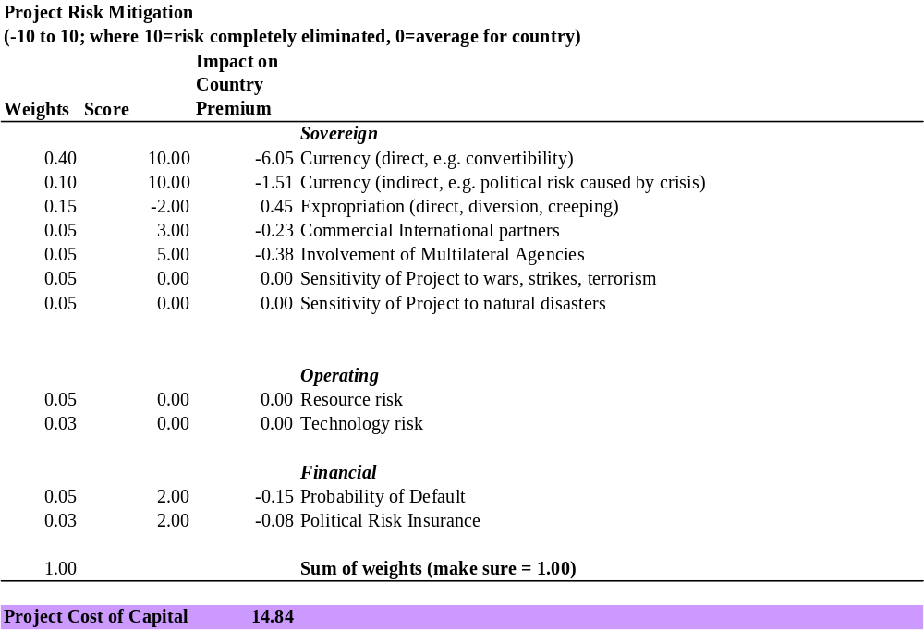
Risk Analysis and Project Evaluation
8. Risk Worksheet

Slide 100
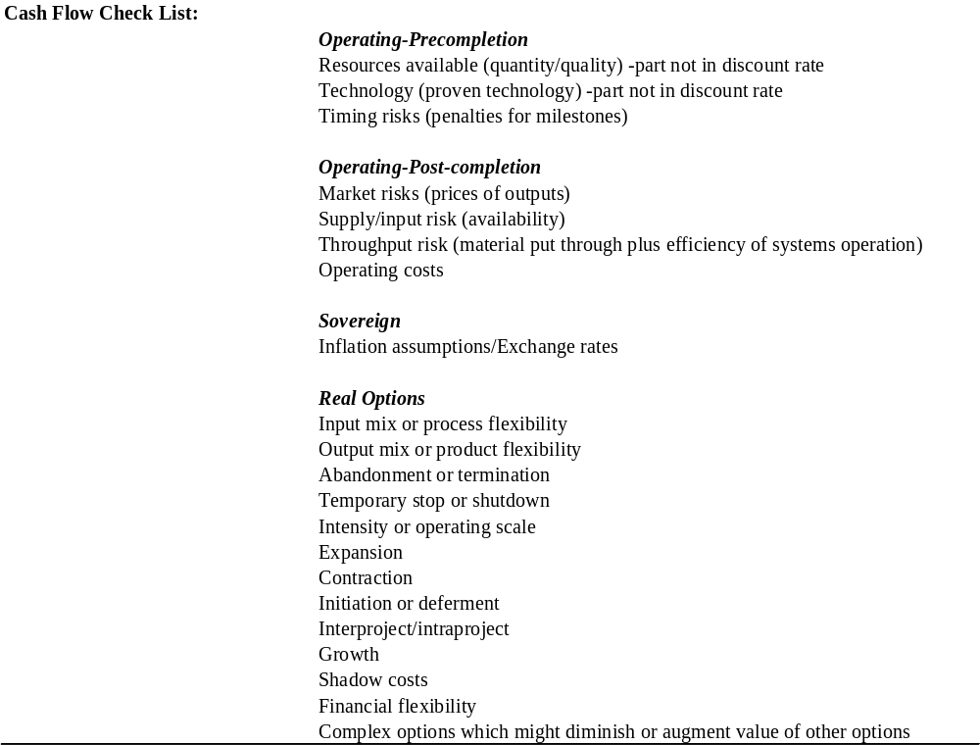
Risk Analysis and Project Evaluation
8. Risk Worksheet

Slide 101
Risk Analysis and Project Evaluation
9. Conclusions
Conclusions
Project evaluation in developing countries is much more complex than in developed countries
Critical to: accurately identify risks and to measure the degree of mitigation – if any.
Each risks need to be handle consistently – either in the cash flows or the discount rate, not both.

Slide 102
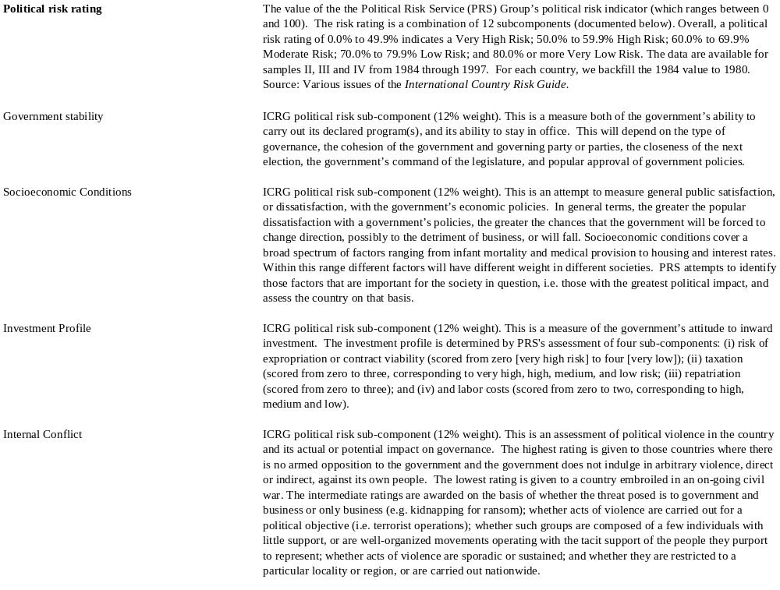
Risk Analysis and Project Evaluation: Risk Ratings Appendix

Slide 103
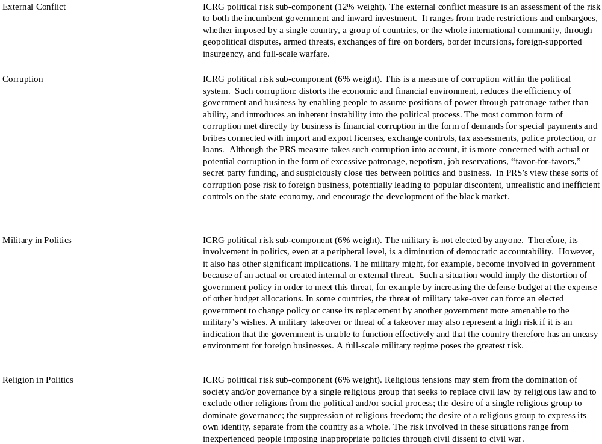
Risk Analysis and Project Evaluation: Risk Ratings Appendix

Slide 104
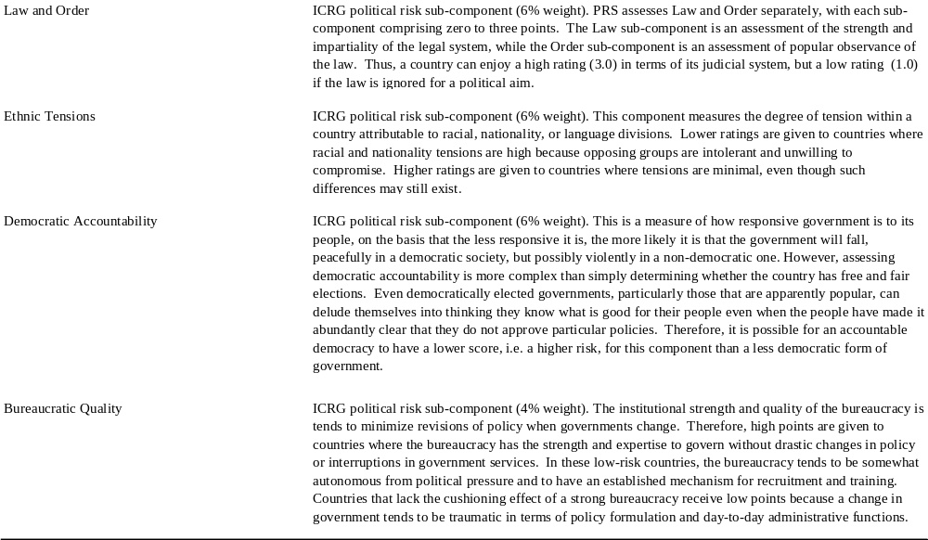
Risk Analysis and Project Evaluation: Risk Ratings Appendix

Slide 105
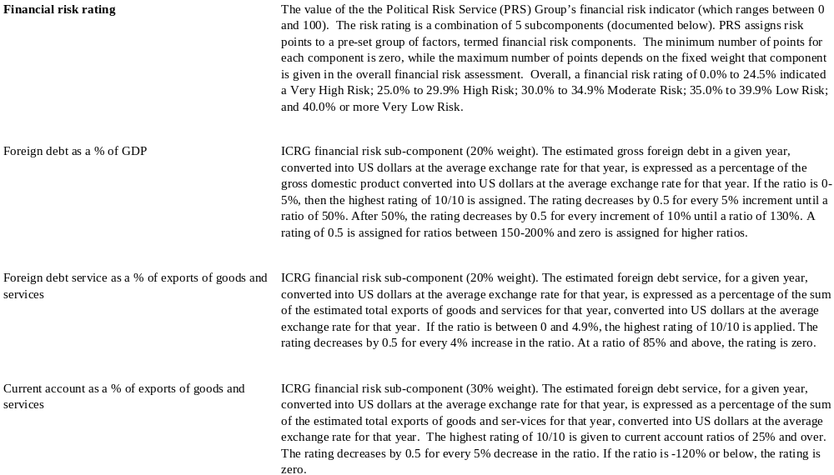
Risk Analysis and Project Evaluation: Risk Ratings Appendix

Slide 106
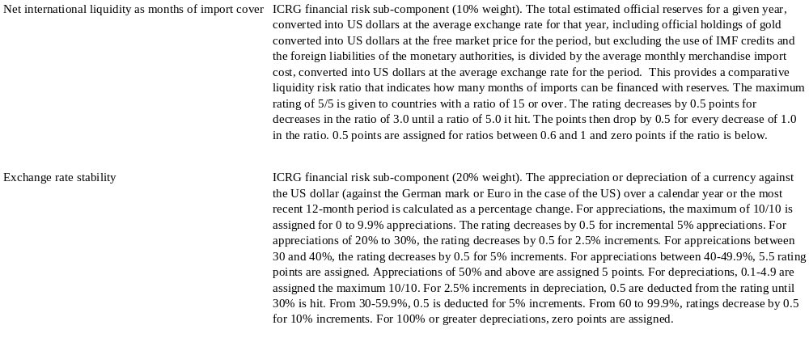
Risk Analysis and Project Evaluation: Risk Ratings Appendix

Slide 107
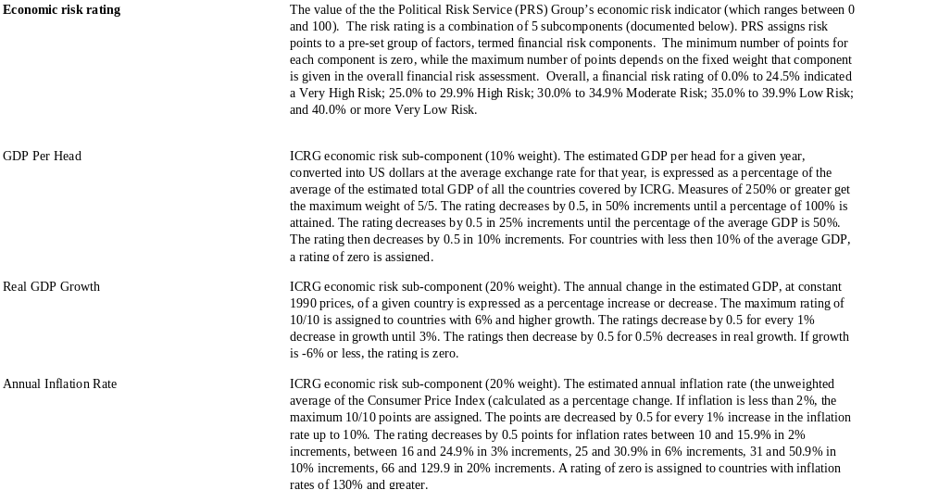
Risk Analysis and Project Evaluation: Risk Ratings Appendix

Slide 108
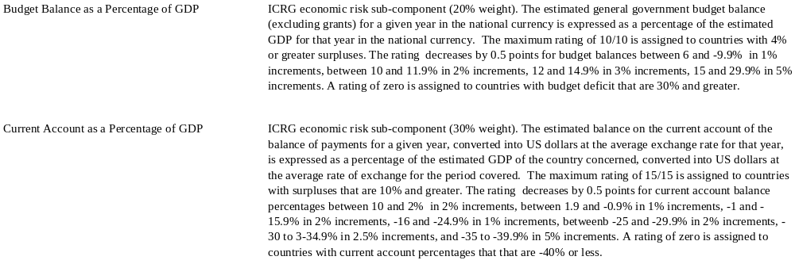
Risk Analysis and Project Evaluation: Risk Ratings Appendix

Slide 109
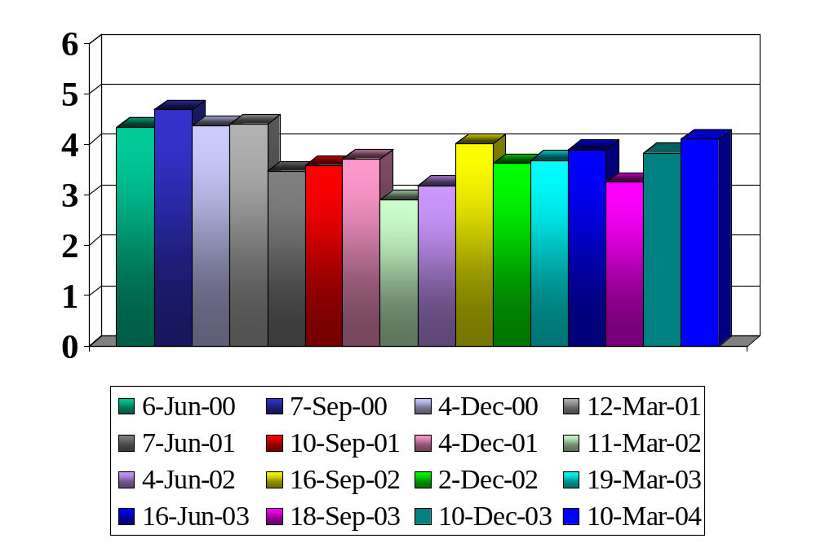
Risk Analysis and Project Evaluation: U.S. Risk Premium
Ten-year risk premium is stable. Currently, about 4%
Source: Graham and Harvey (2004)

Slide 110
Risk Analysis and Project Evaluation: The Author
Campbell R. Harvey is the J. Paul Sticht Professor of International Business at the Fuqua School of Business, Duke University. He is also a Research Associate of the National Bureau of Economic Research in Cambridge, Massachusetts.
Professor Harvey obtained his doctorate at the University of Chicago in business finance. His undergraduate studies in economics were conducted at the University of Toronto. He has served on the faculties of the Stockholm School of Economics, the Helsinki School of Economics, and the Graduate School of Business at the University of Chicago. He has also been a visiting scholar at the Board of Governors of the Federal Reserve System. He was recently awarded an honorary doctorate from Svenska Handelshögskolan in Helsinki.
Harvey is an internationally recognized expert in portfolio management and global risk management. His work on the implications of changing risk and the dynamics of risk premiums for tactical asset allocation has been published in the top academic and practitioner journals. He has published over 100 scholarly articles and books. His work is frequently presented in international conferences and is often featured in the business press.
In addition, Professor Harvey has wide-ranging practical experience. He serves as a consultant to some of the world's leading asset management and consulting firms. Harvey specializes in the construction of global equity and fixed income allocation models as well as providing estimates of the international cost of capital.
Harvey is Editor of the Review of Financial Studies one of the leading publications in finance. In addition, he is an Associate Editor of the Journal of Financial Economics, the Journal of Empirical Finance, the Journal of Fixed Income, the Pacific Basin Finance Journal, the Journal of Banking and Finance, the Journal of International Financial Institutions, Markets and Money, European Financial Management, the International Review of Economics and Finance, and the European Journal of Finance. He is also Co-Editor of the Emerging Markets Review.
Harvey received the 1993-94 Batterymarch Fellowship. This annual award is given to the person that is most likely to establish a new area of research in finance. Harvey has been awarded four Graham and Dodd Scrolls for excellence in financial writing from the Association for Investment Management and Research. The American Finance Association awarded Harvey a Smith-Breeden prize for his publication "The World Price of Covariance Risk" and he has received the American Association of Individual Investors' Best Paper in Investments Award for "Predictable Risk and Returns in Emerging Markets." His paper on the "Dynamics of Capital Flows" recently received the New York Stock Exchange's Best Paper in Equities Award in 2000. Harvey is past winner of the Outstanding Faculty Award at the Fuqua School of Business, an annual award given by the students. He was named by Business Week as one of Duke's outstanding teachers.
Harvey is also active on the Internet. He successfully conducted a live Webcast of his Global Asset Allocation and Stock Selection course. The students participating in the Webcast were from firms that, in aggregate, manage $1.6 trillion. His hypertextual financial glossary is used by The New York Times, Forbes, Bloomberg, The Washington Post, CNN-Money, and Yahoo to name a few of the sites. The glossary, which is the most comprehensive in the world, contains over 8,000 terms and over 18,000 links. He recently published a book with 2002 Pulitzer Prize winner Gretchen Morgenson, The New York Times Dictionary of Money and Investing.

